Slide 1
Logical Design of IoT
P.KALAIVANI,
Assistant Professor/CSE
Kongu Engineering College

Slide 2
Logical Design of IoT
Abstract representation of the entities and processes without going into the low-level specifics of the implementation
Functional Blocks of IoT System
IoT Communication Models
IoT Communication APIs

Slide 3
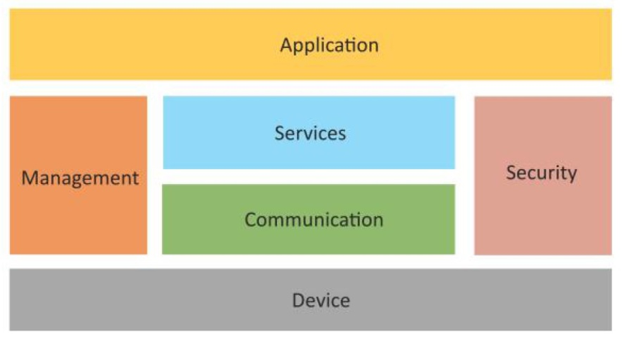
Functional Blocks of IoT
An IoT system comprises of a number of functional blocks that provide the system the capabilities for
Identification
Sensing
Actuation
Communication and
Management.
Device: Provides sensing, actuation, monitoring and control functions
Communication: It handles the communication for the IoT System
Services: Services for device monitoring, device control, data publishing and device discovery
Management: It provides various functions to govern the IoT system.
Security: Secures the IoT system and provide functions such as authentication, authorization, message integrity and data security.
Application: It provides an interface that the user can use to control and monitor various aspects of IoT System.

Slide 4
IoT Communication Models
There are four types of IoT communication models available.
Request-Response communication model
Publish-Subscribe communication model
Push-Pull communication model
Exclusive Pair communication model

Slide 5
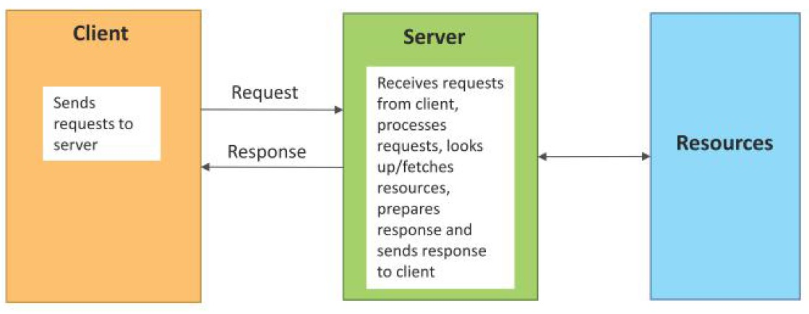
Request-Response communication model
Client sends requests to the server and the server responds to the requests
When the server receives a request, it decides
- How to respond
- Fetches the data
-Retrieves resource representations
-Prepares the response
-Sends the response to the client.
It is a stateless communication model.

Slide 6
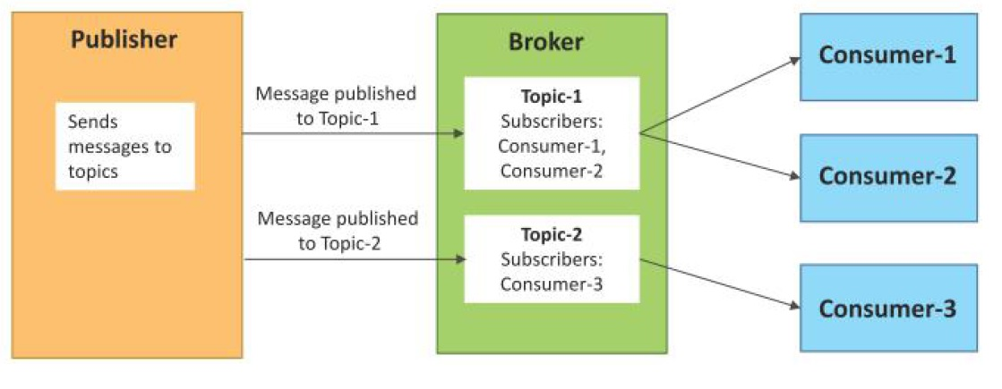
Publish-Subscribe communication model
This model involves publishers, brokers and consumers
Publishers are the source of data
Publishers send the data to the topics which are managed by the broker. Publishers are not aware of the consumers
Consumers subscribe to the topics which are managed by the broker
When the broker receives data for a topic from the publisher, it sends the data to all the subscribed consumers.

Slide 7
Publish-Subscribe Communication Model
Example: Home Heating System
It has a temperature sensor, a heating unit, and a central control unit.
Temperature in the house. Published by the temperature sensor and subscribed to by the central control unit. Has the value of the current in-house temperature.
Heating Request. Published by the control unit and subscribed to by the heating unit. Has the value of either “On” or “Off”.

Slide 8
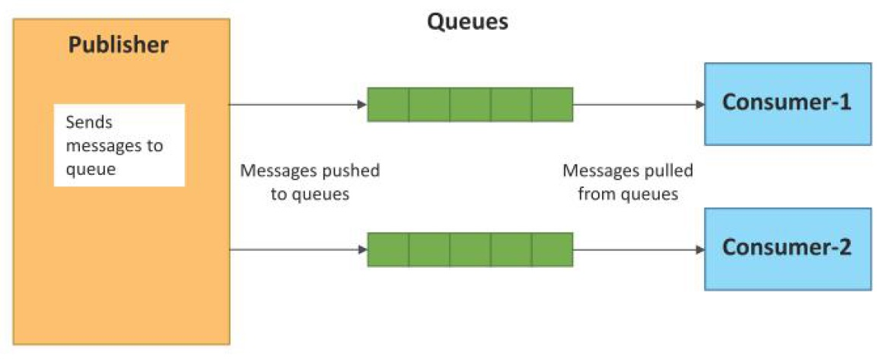
Push-Pull communication model
In this model, the data producers push the data to queues and the consumers pull the data from the queues.
Producers do not need to be aware of the consumers.
Queues : Decouples the message between the producers and consumers.
Queues also act as a buffer (Mismatch between the rate at which the producers push data and the rate at which the consumers pull data)

Slide 9
PUSH –PULL Example
Push communication : Sending information to stakeholders. This method is useful for time sensitive information and when feedback is expected.
Push is a kind of broadcast and as the sender control it, determine which stakeholders receive it, and at what time
Push communication ---Send information to a large pool of stakeholders quickly.
Push : memos, letters, voice mails, etc
Pull communication method ----Stakeholders pull the information as per their requirements.
Pull : blog, intranet, bulletin board, etc.

Slide 10
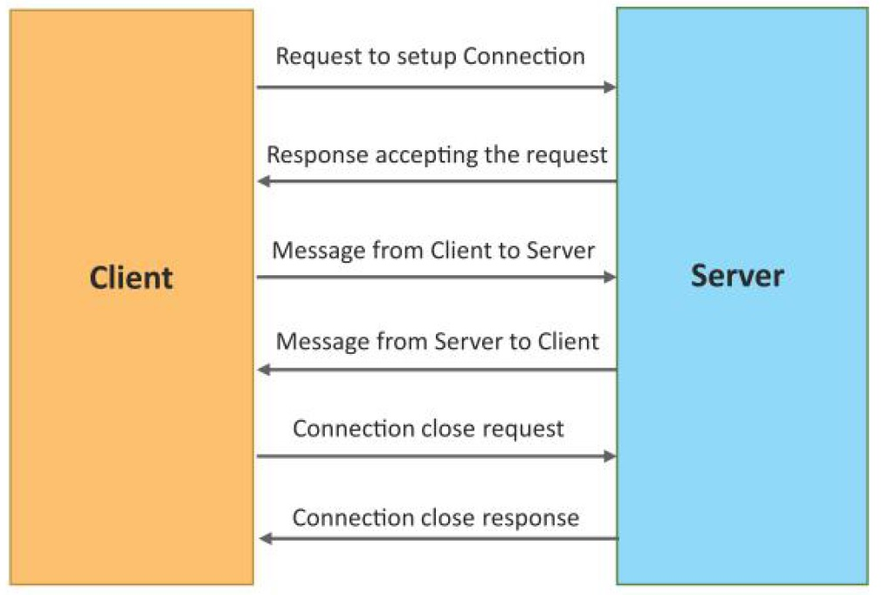
Exclusive Pair communication model
Exclusive Pair is a bidirectional, fully duplex communication model that uses a persistent connection between the client and server.
Once the connection is setup it remains open until the client sends a request to close the connection.
Client and server can send messages to each other after connection setup.

Slide 11
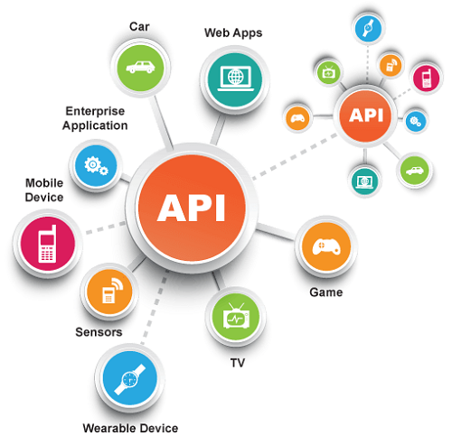

IoT Communication APIs
An Application Program Interface (API) is a set of routines, protocols and tools for building software applications.
API specifies how software components should interact.
Two Communication APIs,
REST – Based Communication APIs
WebSocket – Based Communication APIs

Slide 12

REST – Based Communication APIs
Representational State Transfer (REST) is a set of architectural principles by which web services and web APIs are designed that focus on a system’s resources and how resource states are addressed and transferred.
REST APIs follow the request response communication model
The REST architectural constraints apply to the components, connectors and data elements within a distributed hypermedia system.

Slide 13
REST – Based Communication APIs
The REST architectural constraints are as follows:
Client – Server : Separation, Independent
Stateless : Session state is kept entirely on the client
Cache-able : Improve efficiency and scalability.
Layered System : Intermediate Systems
Uniform Interface : Method of communication
Code on demand : Server can provide executable code for clients. (It is optional)

Slide 14
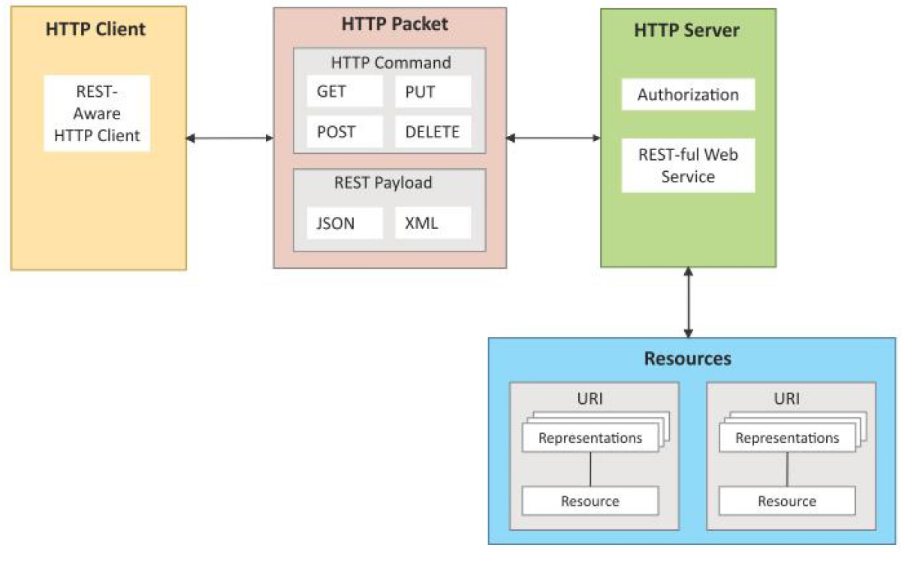
Communication b/w Client and Server using REST APIs
RESTful Web Service:
It is a web API implemented using HTTP and REST principles
It is a collection of resources which are represented by URIs
It has a base URI (Ex: http://example.com/api)
Client send requests to these URIs using HTTP methods ( GET,PUT, POST or DELETE)
It can support various Internet media types (JSON)
IPSO Alliance has published and application framework that defines a RESTful Design.

Slide 15
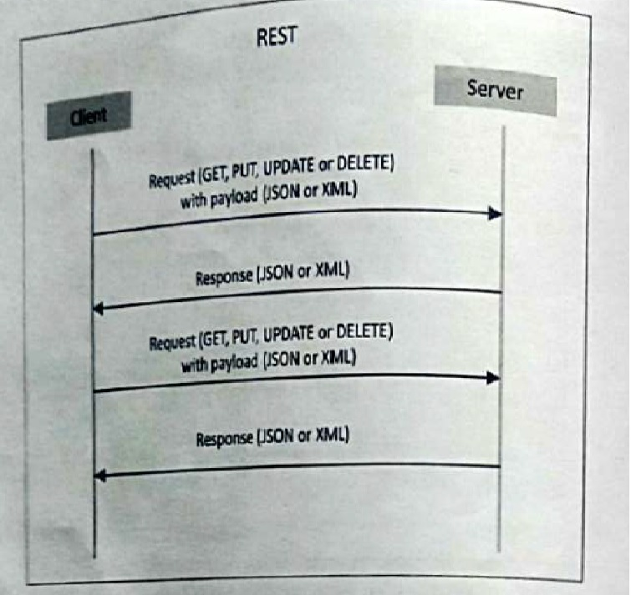
Interaction in the Request – Response Model used by REST

Slide 16
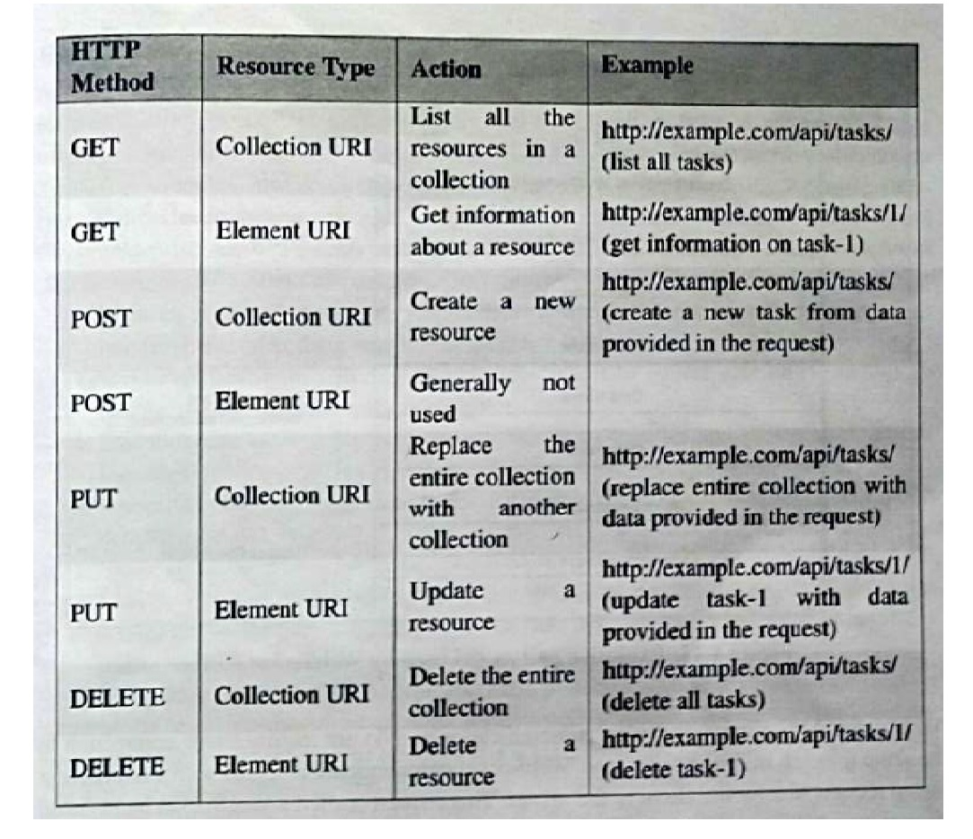
HTTP Methods

Slide 17

Websocket – Based Communication APIs
WebSocket APIs allow bidirectional, full duplex communication between clients and servers
WebSocket APIs follow the exclusive pair communication model
Websockets reduces the network traffic and latency (no overhead for connection setup and termination for each message)
Websockets is suitable for IoT applications that have low latency or high throughput requirements

Slide 18
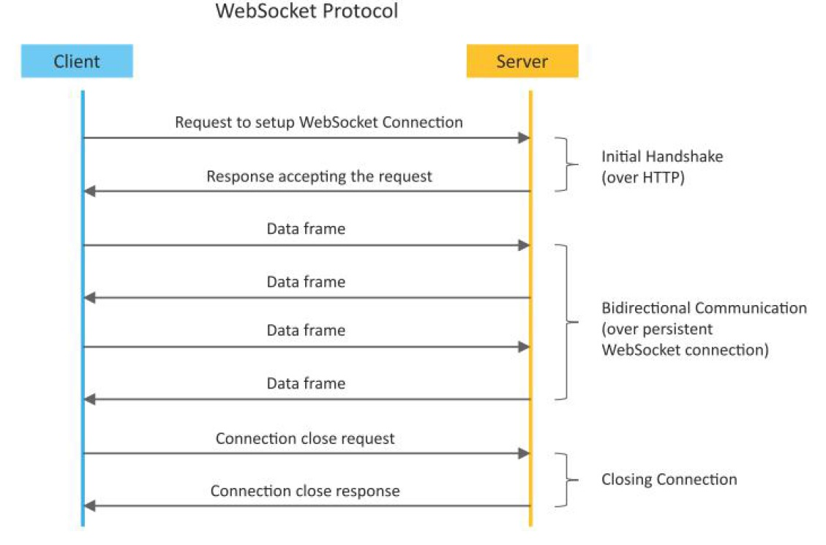
Websocket – Based Communication APIs

